Slide 1
Titanic Survivor Prediction Using Logistic Regression

Slide 2
Introduction
In this case study, the objective is to analyse of what sorts of people were likely to survive.
In Particular, our objective is to focus on implementation of Machine Learning Algorithm “Logistic Regression” and how it can be useful for predicting the survival.

Slide 3
Goals and Objectives
The purpose of this presentation is to document the process we went through to create my predictions for Titanic Survivor Prediction
The objective of this project was to build a classification model that could successfully determine weather a Titanic passenger lived or dead.

Slide 4
Logistic Regression
Logistic Regression is basically a supervised classification algorithm. In a classification problem, the target variable (or output) ,y, can take only discrete values for given set of features(or inputs),X.
Logistic Regression is a useful model to run early in the workflow. Logistic regression measures the relationship between the categorical dependent variable (feature) and one or more independent variables (features) by estimating probabilities using a logistic function, which is the cumulative logistic distribution.
Some of the examples of classification problems are Email Spam or Not Spam prediction, Online transactions Fraud or not Fraud Detection.

Slide 5
Implementation
Importing the necessary libraries
Importing the dataset (or) reading the csv file using Pandas.
Cleaning and analysing the dataset
Building the model
Using Logistics regression for making predictions

Slide 6
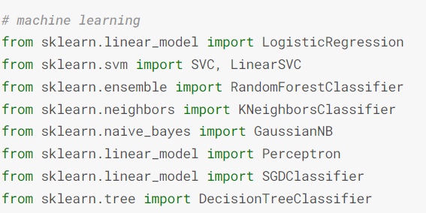
Importing the libraries

Slide 7
Model Building - Steps Involved
We will be splitting the whole data into Train (70%) and Test (30%)sets.
On Train data we will be training the model
The same Train Dataset can be used to adjust the model by tuning the parameters such as applying grid search and random search techniques.
We can use K-Fold Cross validation also to get the better accuracy.

Slide 8
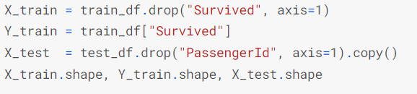
Model Building - Train & Test Data creation
Creation of Train Data and test Data can be observed as shown below.
Here, train_df and test_df was prepared using train_test_split() from Sklearn module.

Slide 9
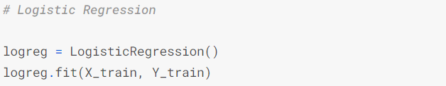
Model Building - Fitting the Model
As shown below, we would be using LogisticRegression() method from sklearn module
We will be using ‘fit’ method to fit the model by supplying both DV and IDV columns
Here, train_df and test_df was prepared using train_test_split() from Sklearn module.
We will be initializing the object with default parameters

Slide 10
Model Building - Default Parameters of the Model
As shown below, some parameters are predefined.
Below is the source for detailed explanation of each parameter
https://scikit-learn.org/stable/modules/generated/sklearn.linear_model.LogisticRegression.html

Slide 11
Model Building - Predicting the scores
We will be predicting the scores using .predict method of the model instance.
For example, if ‘model’ is the model instance then below is the syntax to get the prediction array.
model.predict(x_test)
We can save the model in .pkl format for further use using pickle library.

Slide 12
Model Building - Computing the accuracy
The model object can be used to compute the accuracy score.
To calculate the accuracy, we must the pass the data (predictors & target) as arguments.
Below snapshot shows that, how we can get the train accuracy.
Similarly, we can get the test accuracy also.

